Slide 1


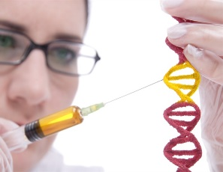

University Of Basrah
Al-Zahraa College Of Medicine
Ministry Of Higher Education
And Scientific Research
Module: Molecule, Gene and Disease
Semester: 2
Session: 5
Lecture: 9
Lecture Title: What is a gene and transcription
Module staff:
Dr. Ban M. Saleh
Dr. Hussein K. Abdul-Sada
Dr. Wameedh Hashim Alqatrani
Dr. Hamid Jadoa
Dr. Farqad M. Al-Hamdani
Dr. Abeer laily Mohammed
Dr. Hazim T. Thwiny
Module staff:
Dr. Ilham Mohamed Jawad
Dr. Shant Sunbat
Dr. Zainab Ahmad
Dr. Myada Abd Allah
Dr. Amani Niama
Mrs. Eatidal Akram Farhan
.
This Lecture was loaded in blackboard and you can find the material in:
(Lippincott’s Illustrated Reviews: Cell and Molecular Biology Chapter 5)
For more detailed instructions, any question, or you have a case you
need help in, please post to the group of session

Slide 2

Learning Objectives (LO)
1. Define the term gene. (LO. 1)
2. Describe the process and role of transcription. (LO.2)
3. List and summarize the major reactions involved the process of RNA maturation in eukaryotes and explain their importance in gene expression. (LO.3)
4. Contrast the different types of RNA molecule, i.e. mRNA, rRNA and tRNA. (LO.4)

Slide 3
The Gene LO. 1
Is the basic physical and functional unit of heredity. It consists of a specific sequence of nucleotides at a given position on a given chromosome that codes for a specific protein (or for an RNA molecule).
a distinct sequence of nucleotides forming part of a chromosome, the order of which determines the order of monomers in a polypeptide or nucleic acid molecule which a cell (or virus) may synthesize.
Protein–coding genes (≈20000-27000 genes): Transcribed into mRNA and encoded for all the proteins.
These protein–coding genes make up 1–2% of the human genome
RNA-coding genes (≈ 3,000 genes): Produce of other forms of RNA molecules having function.
Ex: transfer RNA (tRNA) and ribosomal RNA (rRNA) involved in translation

Slide 4
Transcription does not happen all the time
LO. 1
Each cell in our body has the same protein–coding genes (the same genotype) but not all these genes are expressed in every cell. In a given cell, almost all genes are switched off most of the time and only about 5% to 10% of the genes in most cells are active.
Liver cells, for example, do not express the genes for eye color, and brain cells do not make enzymes that help digest food.
The process of turning genes on and off is called gene regulation.
Different cell types use different genes to expresses different proteins (different phenotype) making them to differ from each other.

Slide 5
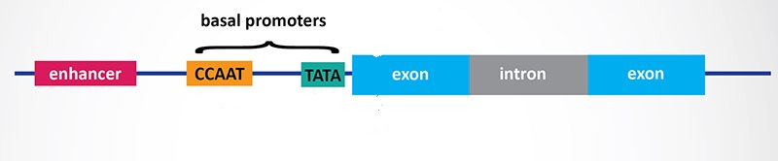
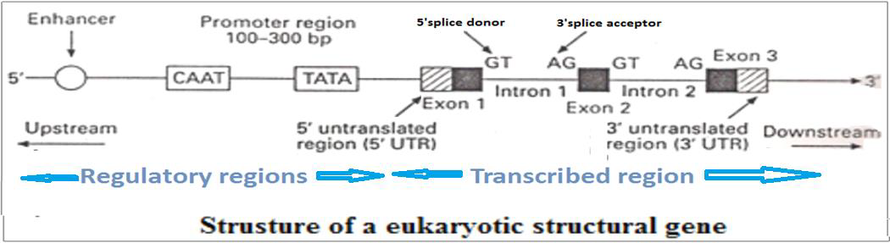
Gene Structure
LO. 1
A typical eukaryotic gene consists of the following regions:
1-Transcribed region: involved exons and introns that transcribed into mRNA.
2-Regulatory regions (Gene control regions): involved Promoter and enhancer and repressor. These regions regulate the transcription of gene

Slide 6
1-Transcribed region: A-Exons
LO. 1
Code for amino acids sequence of the protein.
Present in final mature mRNA molecule.
Numbered from 5'-end of the gene: exon1, exon2, etc.
Exon1 at 5'-end of the gene consist of:
a-Untranslated region(5'UTR): non-coding
b-Coding region that began with initiation codon (ATG) specify methionine.
Last exon at 3'-end of the gene consist of:
a-Coding region ends with stop codon(TAA,TAG,TGA: do not specify amino acid)
b-Untranslated region (3'UTR): non-coding
5'UTR is leader of mRNA strand and 3'UTR is tailing.
Mutations in the exons (point, frameshift mutations, etc.) usually lead to abnormal protein.

Slide 7
LO. 1
1-Transcribed region: B-Introns
Do not code for amino acids.
Removed (spliced) from the mature mRNA.
Each intron always began and ends with consensus sequence:
GT at 5'-end (5'splice donor)
AG at 3'-end (3'splice acceptor).
These are essential for splicing introns out of the primary transcript.
Mutation at splice sites (split mutation) result in abnormal protein.

Slide 8
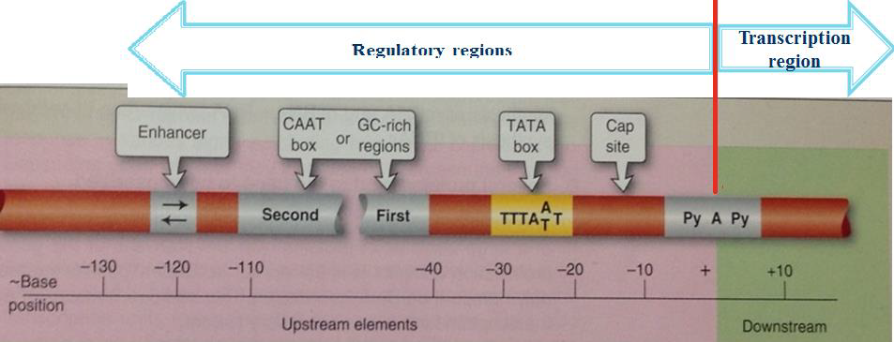
1-Transcribed region:
LO. 1
This region start with the base (pyrimidine A pyrimidine) serve as start site (start point) for transcription, numbered +1, which is first nucleotide incorporated into the RNA at the 5'-end.
Nucleotides after start point in the transcribed region are numbered +2, +3, etc., the direction is called downstream, towards 3' end.
Nucleotides before start point in the regulatory region are numbered -1, -2, etc., the direction is called upstream, 5' end.

Slide 9
2-Regulatory regions (gene control region)
LO. 1
numbered –1, –2, –3, etc. from the start point and the direction is called upstream, included:
A- Promotor: Found in the upstream of the gene and control the transcription of the gene by determining the start point and frequency of transcription by controlling the binding RNA polymerase II
Promoter has two Consensus sequences:
1) TATA box: located at -25 region. Binds with general transcriptional factors and directs the RNA polymerase II to the correct site (start point) and ensures fidelity of initiation. Mutations reduce the accuracy of the start point of transcription of a gene.
2) GC-rich regions and CAAT boxes: located region between –40 and –110. Determine how frequently of the transcription event occurs by binding specific
proteins.

Slide 10
LO. 1
B-Enhancers and repressors: Regulate gene expression by binding with specific transcription factors.
1)Enhancers: bind the specific transcription factors (activators or trans activator) that increase the rate of transcription.
2)Silencers or repressor: bind other specific transcription factors (repressors) that depress the rate of transcription

Slide 11
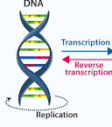
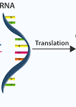

The Central Dogma of Molecular biology
LO. 2
In most organism DNA is the storage of genetic information with exception of RNA viruses.
The Central Dogma: is the flow of information from DNA to RNA to Protein
Retrovirus: ex : human
immunodeficiency virus (HIV): The information flow:
Reverse transcription
Genotype Genes
Phenotype Protein
RNA DNA RNA Protein

Slide 12
Gene Expression
LO. 2
Is the process by which the genetic code (the nucleotide sequence) of a gene is used to direct protein synthesis and produce the structures of the cell.
The information from a gene is used in the synthesis of a functional gene product. These products are often proteins, but in non-protein-coding genes such as transfer RNA (tRNA) or small nuclear RNA (snRNA) genes, the product is a functional RNA.
The process by which specific genes are activated to produce a required protein. An organism's phenotype is determined by the proteins produced, depending on environmental factors.
Made up of the transcription and translation of DNA sequences. This involves RNA.

Slide 13
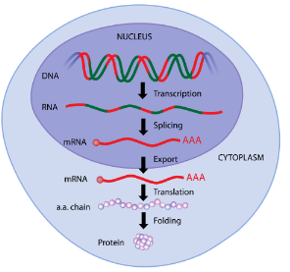
Gene expression involves two main stages:
LO. 2
1-Transcription:
Transfer of genetic information from the base sequence of DNA to the base sequence of RNA, mediated by RNA synthesis that occur at nucleus.
2- Translation
Conversion of information encoded in the nucleotide sequence of an mRNA molecule into the linear sequence of amino acids in a protein that occur at cytoplasm

Slide 14
Transcription
LO. 2
Phases of the transcription process: Pre-mRNA Synthesis
There are three phases in transcription process:
Initiation: promoter recognition and binding.
2. Elongation: chain transcribe by RNA polymerase II (5'→3' growing chain).
3. Termination: a sequence-dependent termination of RNA chain growth.

Slide 15
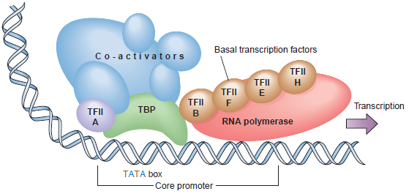
1. Initiation:
promoter recognition and binding.
LO. 2
Involved Formation of the basal transcription complex as following: The general transcription factors (basal factors) at least six, bind to the TATA box and facilitate the binding of RNA polymerase II and is aligned at the start point.
Basal transcription complex can transcribe at a basal level.
The rate of transcription can be increased by binding specific transcriptional factor (activators) to the enhancer.

Slide 16
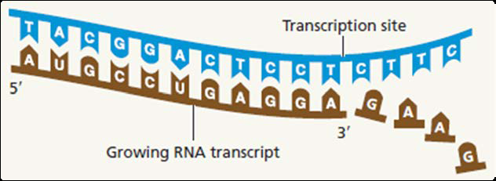
2.Elongation:
Chain transcribe by RNA polymerase II (5'→3' growing chain).
LO. 2
RNA poly II recognize the start point and DNA template, RNA poly II reads the antisense strand (3'→5') of DNA as a template strand that is copied to produce 5'→3‘ RNA strand depending on the Watson- Crick complementary.
Do not need primer and catalyze 3'→5‘ phosphodiester bond.
RNA poly has synthesis at rate about 30-40 nucleotides per second.
RNA strand has exactly the same sequence as the 5'→3‘ sense strand DNA , except that the uracil base instead of thymine: 5'-UAGCU- 3'

Slide 17
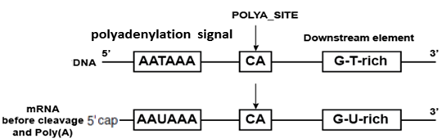
3.Termination
a sequence-dependent termination of RNA chain growth.
LO. 2
RNA polymerase moves along the DNA template, reaching a 3‘ termination sequence called the polyadenylation signal (AAUAAA). RNA polymerase continues past the polyadenylation signal until it reaches an unknown, then stops and falls off the DNA template strand.
The pre-mRNA molecule is released and the DNA strands re-form a double helix..
Mutation at polyadenylation signal (AAUAAA) will reduce the amount of mRNA.

Slide 18
Transcription
LO. 3
RNA processing reactions: pre-mRNA (hnRNA) convert into mature mRNA
1-Capping: addition of a 5´ cap
Began immediately after the initiation of RNA synthesis: by adding a methylated guanosine(modified guanosine) to the 5’ end (leader sequence) of the transcript by RNA poly II
protects it from degradation by 5’-exonucleases during elongation of RNA chain.
Increase the efficiency of translation of the mRNA by helping the transcript bind to the ribosome during protein synthesis

Slide 19
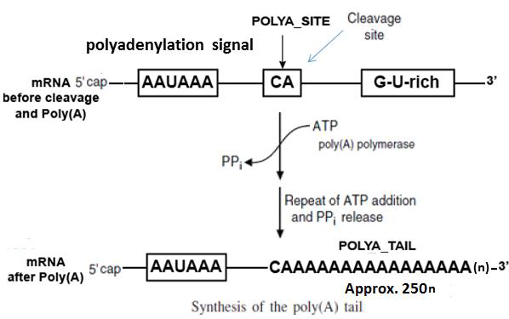
Transcription
LO. 3
2-Tailing (polyadenylation): addition of a 3´ poly A tail
Add poly A tail (>200 adenine nucleotides) to 3´ terminus by poly A polymerase.
The poly(A) tail protects the mRNA from degradation By 3‘ exonucleases.
Help in mRNA export: the mature mRNA complexes with poly A-binding protein and other proteins to migrate from nucleus into cytoplasm through nuclear membrane pores.

Slide 20
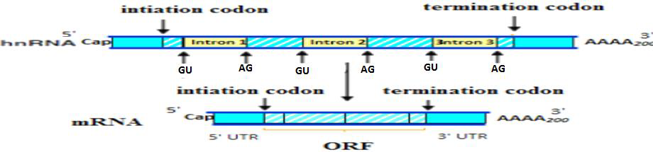
Transcription
LO. 3
3-Splicing: Introns are removed (spliced) and exons are joined together to form the mature mRNA.
Split site sequences: beginning (GU/5‘ splice donor) and ending (AG/3‘ splice acceptor) of each intron, which are essential for splicing introns out of the primary transcript.
The exons joined together to form Open Reading Frame (ORF), which is coding amino acids sequence.
☺ Introns are in-between…
Exons are expressed…

Slide 21
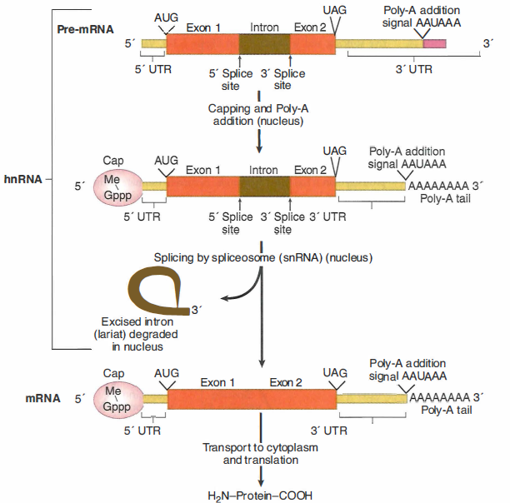
LO. 3

Slide 22
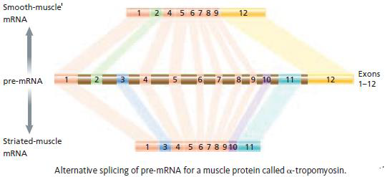
Individual gene can produce different mRNAs coding to different proteins due to:
LO. 3
Alternative splicing: Produced different splicing products. Alternative splicing represent the ability of genes to form multiple processed mRNA contain different combinations of exons that coding to multiple proteins.
Use of different transcription initiation sites.

Slide 23
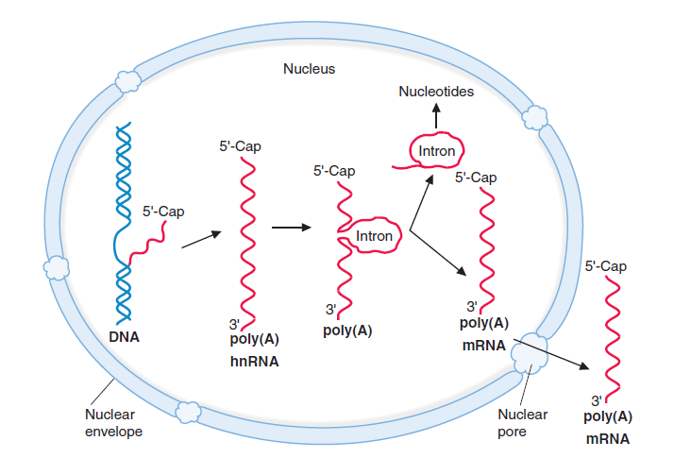
Overview of mRNA Synthesis
LO. 3

Slide 24
Matching bases of DNA & RNA
LO. 4
U instead of T is matched to A
DNA
TACGCACATTTACGTACGCGG
mRNA
AUGCGUGUAAAUGCAUGCGCC

Slide 25
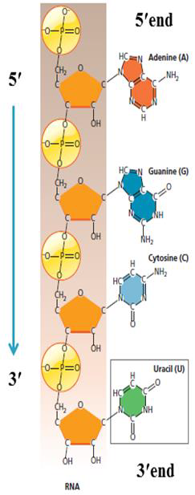
Review of RNA Structure
LO. 4
RNA: Is polymer of ribonucleotides covalently Linked by phosphodiester bonds.
RNA: is single strand that has direction from5'→3‘ and Bases sequence always written from5'-end to 3'-end: 5'-AGCU-3'.
Phosphodiester bonds: Can be cleaved hydrolytically by chemicals, or hydrolyzed Enzymatically by nucleases (ribonucleases):
a)Endonucleases: Cut the sugar-phosphate backbone within the sequence, either non-specifically or in a specific sequence (i.e. At a particular site or sites along the strand
b)Exonucleases: Remove one nucleotide at a time from the ends of the molecule, either in a 5’-specific manner or from the 3’ end.

Slide 26
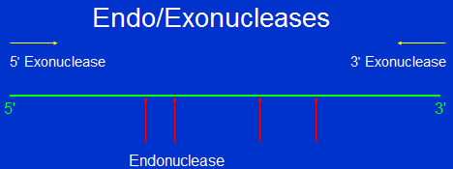
Review of RNA Structure
LO. 4
Exonucleases: are enzymes that work by cleaving nucleotides one at a time from the end of a polynucleotide chain. A hydrolyzing reaction that breaks phosphodiester bonds at either the 3' or the 5' end occurs.
Endonucleases are enzymes that cleave the phosphodiester bond within a polynucleotide chain. Some, such as deoxyribonuclease I, cut DNA relatively nonspecifically, while many, typically called restriction endonucleases or restriction enzymes, cleave only at very specific nucleotide sequences.

Slide 27
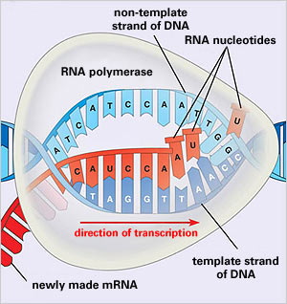
How is RNA made?
LO. 4
*** Remember that there are no T’s in RNA. Uracil (U) is used in place of thymine (T)***

Slide 28
Types of RNA LO. 4
1-Ribosomal RNA (rRNA): 18S, 28S, 5S, and 5.8S (80% of all RNA)
18S, 28S, and 5.8S rRNA genes present in many copies and expressed together, which transcribed into rRNA in Nucleolus by RNA polymerase I.
5S rRNA produced by RNA polymerase III in the Nucleus.
rRNA comprise 80% of total RNA in the cell and associates with proteins to form ribosomes.
2-Transfer RNA (tRNA):
tRNA genes are often multi- copy clusters expressed together, which transcribed into tRNA by RNA polymerase III in the nucleus.
It has ability to carry the appropriate amino acid in the protein synthesis.
3-Messenger RNA (mRNA): (5% of all RNA)
Carries specific information necessary for the synthesis of different proteins.
mRNA genes are single copy, which transcribed into mRNA in nucleus by RNA polymerase II.

Slide 29
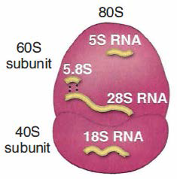
Ribosomes
LO. 4
Ribosomes are large complexes of protein and ribosomal RNA, assemble in the nucleolus and function as protein synthesizer (protein factory).
A ribosome consist of two subunits;
A large subunit
A small subunit.
Eukaryotic ribosomal subunits are:
Larger subunit = 60S
Smaller subunit = 40S.
Total ribosomal complex = 80S
(formed by joining of the 2 subunits during protein synthesis).
☺ Ribosome found in both prokaryotes & eukaryotes ( except sperm & RBC)
The large ribosomal subunit - catalyzes formation of the peptide bonds that link amino acid residues in a protein.
The small ribosomal subunit - binds mRNA and is responsible for the accuracy of translation by ensuring correct base-pairing between the codon in the mRNA and the anticodon of the tRNA.

Slide 30
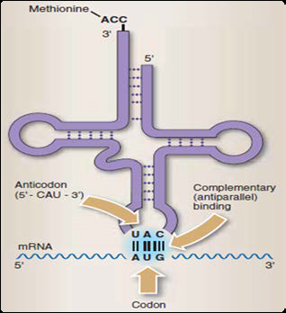
Transfer RNA (tRNA)
LO. 4
tRNA genes are often multi-copy clusters expressed together, which transcribed into tRNA by RNA polymerase III in the nucleus.
tRNAs are adapters between amino acids and the codons in mRNA molecules.
The amino acid is covalently attached to the 3’ end of a specific tRNA.
Anticodon sequence on a tRNA determines which of the 20 amino acids it will transport. For example, a tRNA with anticodon sequence UUC will always transport the amino acid phenylalanine

Slide 31
You can find more details of DNA transcription in these videos
https://www.youtube.com/watch?v=gG7uCskUOrA
https://www.youtube.com/watch?v=_Zyb8bpGMR0

Slide 32
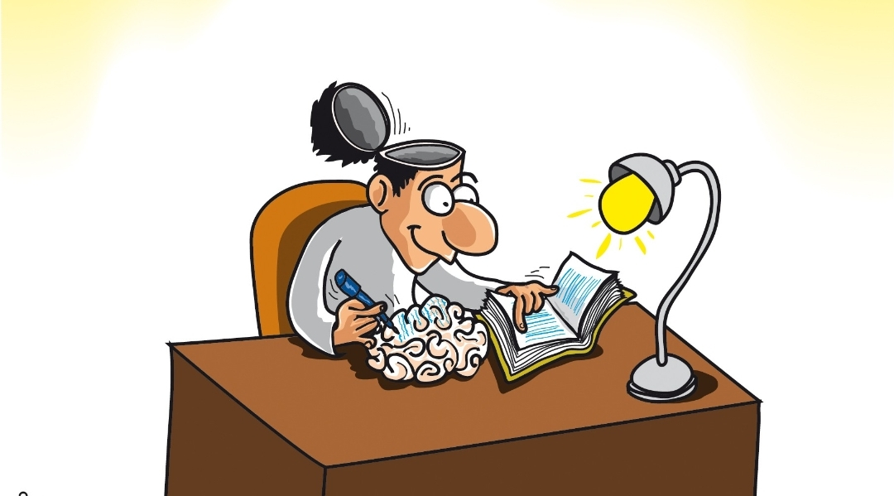
H. W.
What are the types of promotor?
Define the functional RNA
What are the differences between transcription in mammalian and bacterial cells?

Slide 33
